Slide 1
ALERTS
IFRAMES
WINDOWS/TABS

Slide 2
Agenda
• Alerts • Iframes • Tabs/windows

Slide 3
After today’s session you should be able to:
• Handle different browser pop ups
• Switch between iframes
• Switch between multiple windows

Slide 4
Pop up
Anything that comes out of the browser
JavaScript alerts
Modals
Dialogs

Slide 5
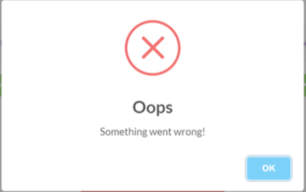
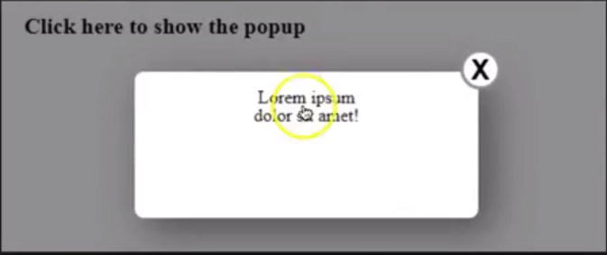
Browser pop up / HTML ALERT
Part of html
Does not always block the web page
Can be located using usual locator
Basically you can right click and inspect

Slide 6
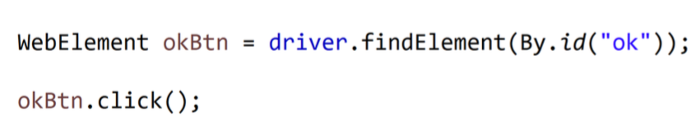
Browser pop up / HTML ALERT
Can be treated as a regular WebElement
Subject to same actions as click(), sendKeys() etc

Slide 7
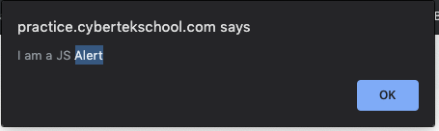
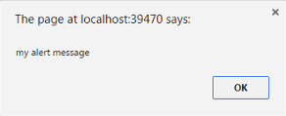
JavaScript alerts
JavaScript alert is a type of a pop up
Blocks the page when present, you canNOT do anything else until you deal with the alert.
User has to accept or cancel
Not part of html

Slide 8
There are 3 types of JavaScript alerts
Warning/information alert (you have one button only, just accept)
Confirmation alert (you have an option to say accept/decline)
Prompt alert (they ask something from you)

Slide 9
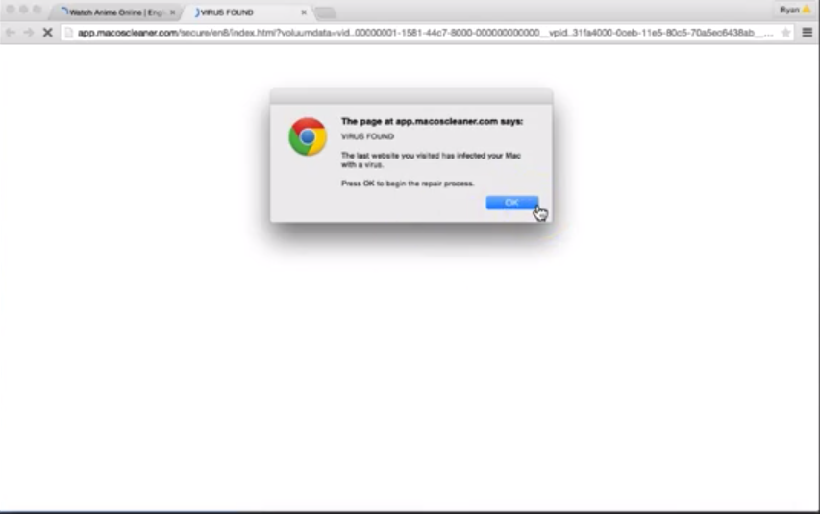
Warning/Information alert
You have one button only.

Slide 10
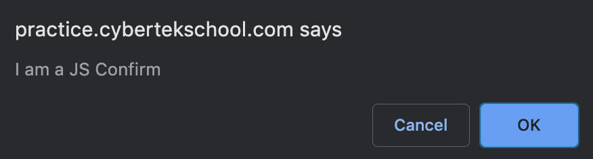
Confirmation alert: you have an option to say accept/decline

Slide 11
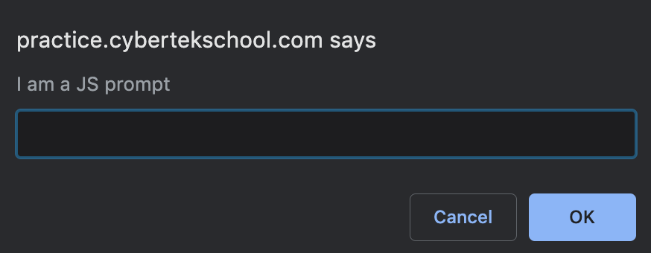
Prompt alert: asking information from you to enter

Slide 12
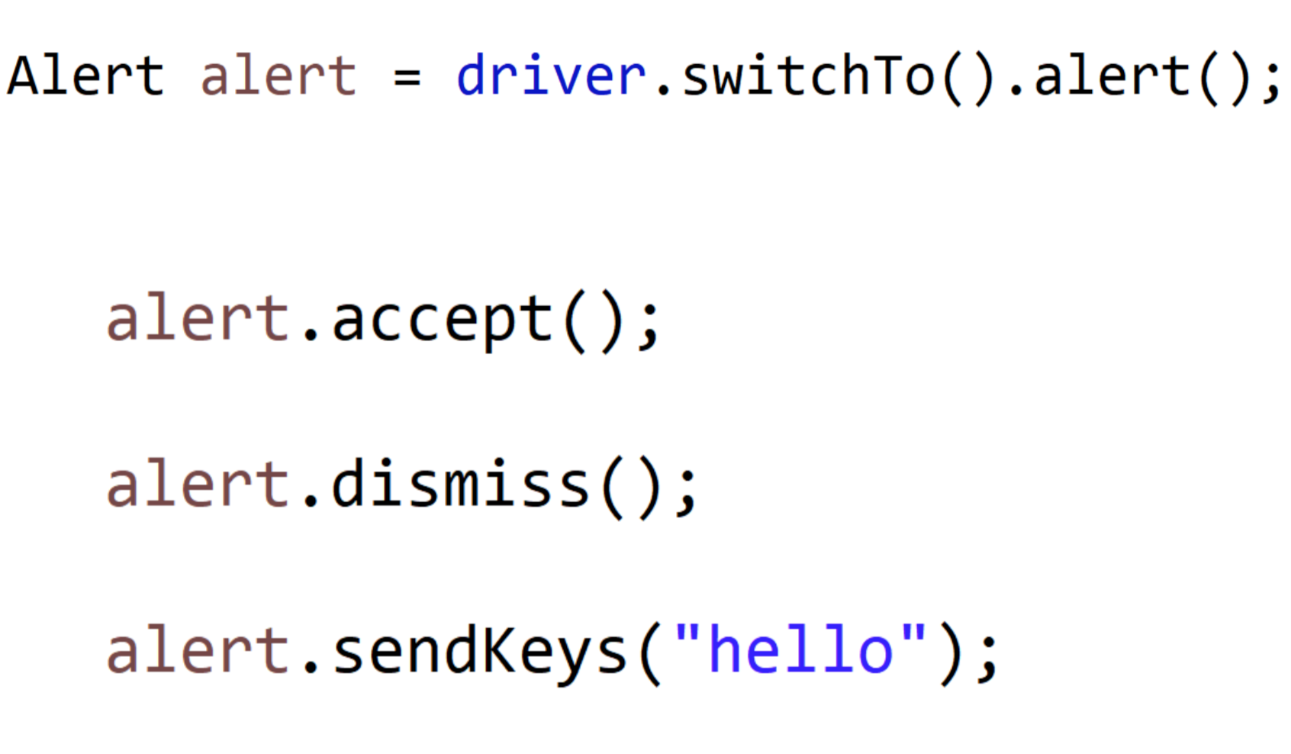
JavaScript alert syntax

Slide 13
Iframes
Html page inside another html page
Used to put content from one page into another
Ads, video players etc…
Created using iframe tag

Slide 14
Example iframe
Amazon.com

Slide 15
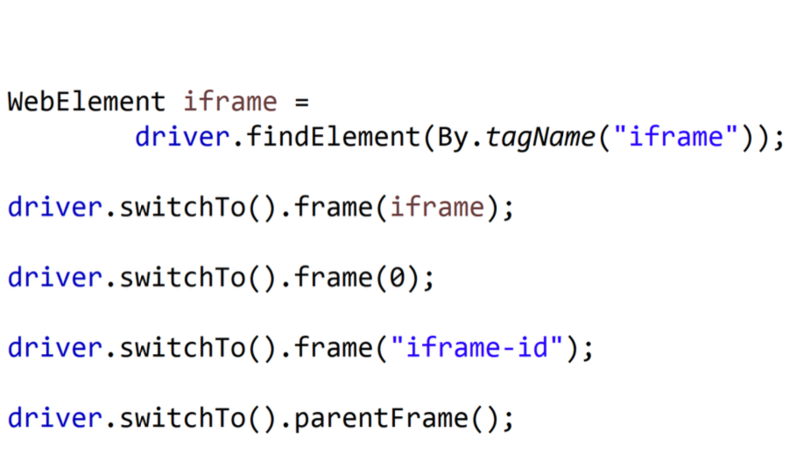
How to handle iframe: syntax
1
2
3
←After you are done, you need to switch back to the parentFrame.

Slide 16
Multiple windows
For selenium there is no difference between tab or window
Every tab/window is a separate window
Selenium can focus & control one window at a time
We can switch to windows using window handles

Slide 17
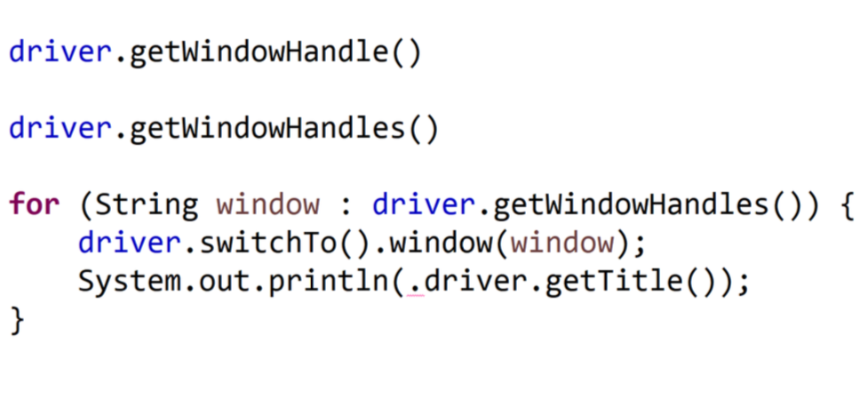
How to handle multiple windows

